Slide 1


Slide 2
Voluntary and continuous organization
Permanent association of workers
Dynamic social institutions
Their basic objective
Ability of facing challenges
Origin and growth of trade unions influenced by different ideologies
Outcome of an individualistic society
Formed by whom and main objective
Works as a collective agent

Slide 3


There are several organizations of trade unions in India, which are recognized as the governing bodies of trade unions.
They are :-
1.) Indian National Trade Union Congress

Slide 4
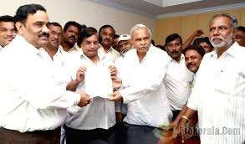

2.)National Mazdoor Union
3.)All India Trade Union Congress

Slide 5
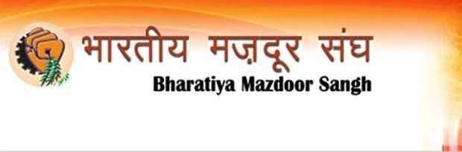

4.) Bhartiya Mazdoor Sangh
5.) Centre of Indian Trade Unions

Slide 6
All basic definitions and concepts that are required to understand the Trade union , 1926 are as follows :
Appropriate Government [sec.2]
Executive[sec.2(a)]
Office bearers [sec.2(b)]
Registered Office [sec.2(d)]

Slide 7
Registered Trade Union [sec.2(e)]
Registrar [sec.2(f)]
Trade Dispute [sec.2(g)]
Workmen [sec.2(g)]

Slide 8
Sec 3 Appointment of registers
Government will appoint required number of person to be a registrar . It will also appoint required number of persons as the addition or the deputy registrar of the trade unions .
Sec 4 ( minimum requirement of registration of trade union- 2001
amendment ) i.e Mode of Registration
No trade union shall be registered unless minimum 10% or 100 of
workmen which ever is less engaged or employed are it’s members
On the date of making the application at least 7 persons are it’s members

Slide 9

Sec 5 Application of Registration
Application shall be made to the registrar.
Must be accompanied by a copy of rules of trade union and also with names occupation and addresses of applicants.
Titles ,names ,ages ,addresses and occupations of the office bearers .
If trade union already exists more than a year then submition of a general statement of the assets and liabilities becomes necessary .

Slide 10

Sec 6 Provision to be contained in the rules of the trade union
Name
Object
General funds
Maintenance of list of members of trade union
Half of it’s members of the trade union must be the member of the trade union
payment of minimum subscription of a member
Rural worker- Rs. 1 per year
Workers in unorganized sector – Rs.3 per year
Any other case – Rs.12 per year

Slide 11
Sec 7
Power to call for further particulars and to regulate alteration of name .
If the registrar is not satisfied with the information
provided by the members of the trade union or
If the name of the trade union already existed or similar to other registered trade union names
Sec 8 Registration
When all documents submited with details and information is correct as well as the registrar is satisfied the registrar will register the trade union .

Slide 12
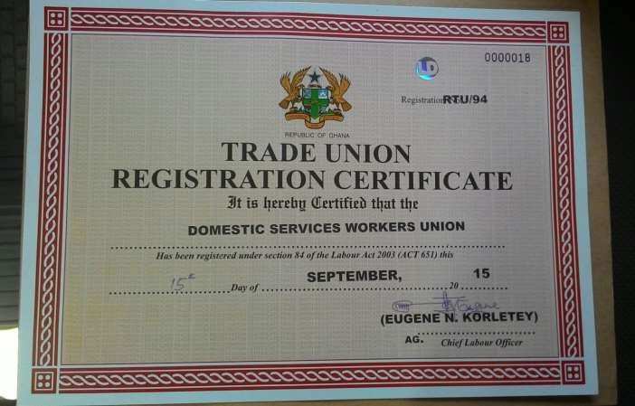
Sec 9 certificate of registration
The registrar registering the trade union under section 8 shall issue a certificate of registration in the prescribed form which shall be conclusive evidence that the trade union has been duly registered under this act

Slide 13

Sec 9A Minimum requirement about membership of a trade union
Any person who has attained the age of 15 years can become a member of trade union but cannot become an office bearer until the age of 18
Any ordinary person can also become a member as long as half of the members of trade union are engaged to the industry

Slide 14
Sec 10 Cancellation of registration
A certificate f registration of trade union may be withdrawn or cancelled by registrar in the following cases.
When application is not verified as prescribed
It the registrar is satisfied that –
a.) Certificate has been obtained by means of fraud b.) By means of mistake
c.) trade union ceased to exist
d.) if any other provision under sec 6 of this act is broken
When there are no minimum required members in the trade
union

Slide 15

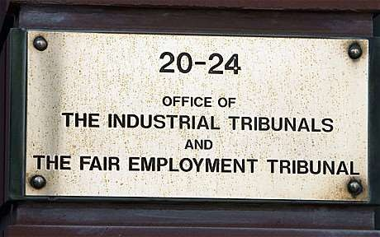
Sec 11 Appeal
If registrar stops the registration of the trade union or withdrawal of the registration , members of the trade union can to labor court court or an industrial tribunal , within jurisdiction which includes high courts and civil courts too but within 90 days of the date on which the registrar passes the notice .

Slide 16


Rate of Subscription of union members [sec.6(ee)] :-
section (6)(ee) of the trade union act 1926 , provides that the payment of minimum subscription by member shall not be less than ;
One rupee per annum for rural workers ;
Three rupee per annum for workers in other unrecognized sector ; and
Twelve rupee per annum for workers in other

Slide 17
General fund [sec.15] :-
Sec.15 object on which general funds may be spent-The general funds of a registered Trade Union shall not be spent on any other objects than the following , namely :-
the payment of salaries allowance and expenses to office
bearers of the trade union
payment of expenses for the administration of the trade union
the conduct of trade disputes on behalf of the trade union or any member thereof ;

Slide 18

allowance to member or their dependants on account of death, old age, sickness , accidents or unemployment of such member.
the issue of or the undertaking of liability under , policies of assurance on the lives of members, or under policies insuring member against sickness etc.
The provisions of educational ,social or religious benefits for members .

Slide 19

Political fund [sec.16] :-
The trade unions which are registered are permitted as per sec 16 of the act to raise separate political fund for it’s members .
The political fund can be use for the following expenses:
For holding the meeting .
For distribution of any documents.
For holding political meeting .
For registration of electors

Slide 20




Sec 15 Objects on which general funds
be spent
can

Slide 21
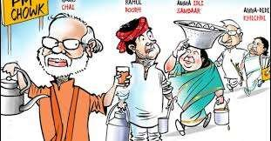

SEC 16 Constitution of a separate fund for political
purposes
Sec 17 Criminal conspiracy in trade disputes

Slide 22


Sec 18 Immunity from civil suit in certain cases
Sec 19 Enforceability of agreements

Slide 23


Sec 20 Right to inspect books of trade unions
Sec 21Right of minors to membership of trade unions

Slide 24


Sec 21 A Disqualification of office bearer of trade union

Slide 25

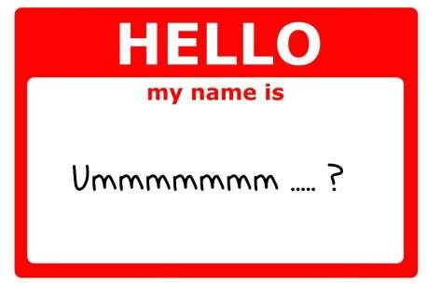
Sec 22 Proportion of office bearer to be connected with the industry
Sec 23 change of name

Slide 26


Sec 24
Amalgamation of trade union
Sec 25 notice of change of name or amalgamation

Slide 27


Sec 26 Effects of change of name or amalgamation
Sec 27 Dissolution

Slide 28


Sec 28 Returns
Sec 11 Appeal

Slide 29
Offences | Penalties
If the registered trade union or its office bearers or members fail to give any notice or send any statement as required under the act under sec.31(1) | Fine up to ₹ 5 + additional fine up to ₹ 5 per week in case of continuous offence ( maximum fine up to ₹ 50 )
If any person willfully makes any false entry in the annual statement of the union or it’s rules. | Fine up to ₹ 500
If any person , with intent to deceive , gives an incorrect copy of rules of the union to any member or a prospective member under section 32. | Fine up to ₹ 500

Slide 30


